Slide 1



programmed Learning
Material
w. jeni hetsiya

Slide 2



Introductory Frame
What is in this picture?

Slide 3
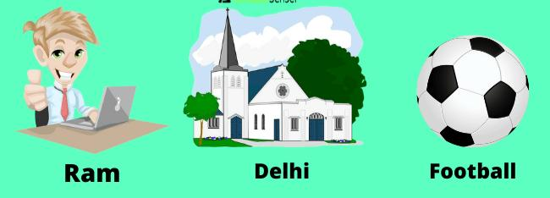
Definition of proper noun :
A proper noun is a noun that serves as the name for a specific place, person, or thing.
My dog’s name is ___________
a) Brownie b) Students
c)Money d) Gold

Slide 4

Definition of common noun
A Common noun is a non-specific person, place, or thing.
For example, dog, girl, and country are examples of common nouns.
In which _________ did your son study?
a) Kavitha b) school
c)Monday d)Sand

Slide 5
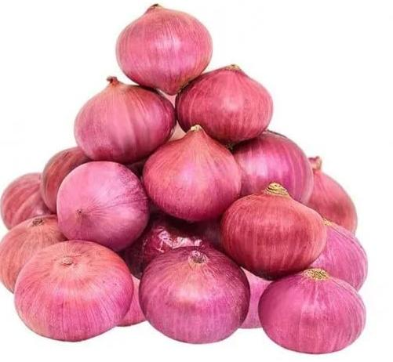
Countable Noun
Definition:
countable Nouns, or count Nouns, are words that we can easily put a number next to.
_____ fell from his carry bag.
a)Hair b)Star
c)Onions d)Table

Slide 6
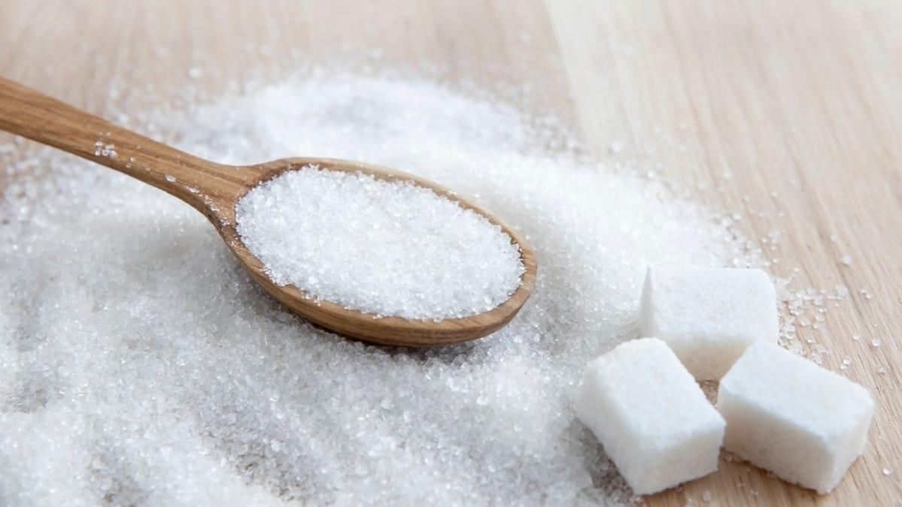
Definition of uncountable Noun
Uncountable nouns are for the things that we cannot count with numbers.
______ is essential for lifestyle.
a)Princely b)Chennai
c)Students d)Education

Slide 7

Countable Noun
Onion
Pen
School
SUMMARY
Common noun
Students
Girl
Teacher
Proper noun
Princely
Yellow
Chennai

Slide 8


Testing frame
All the best
I brought a _____ yesterday a) book b) Chennai
________ is a very good player a) gold b) alex
Give example for countable noun________
Give example for uncountable for _________

Slide 9


Slide 10

GO TO NEXT SLIDE

Slide 11

GO TO NEXT SLIDE

Slide 12

GO TO NEXT SLIDE

Slide 13

GO TO NEXT SLIDE

Slide 14

TRY AGAIN

Slide 15

RETURN

Slide 16

TRY AGAIN

